Slide 1

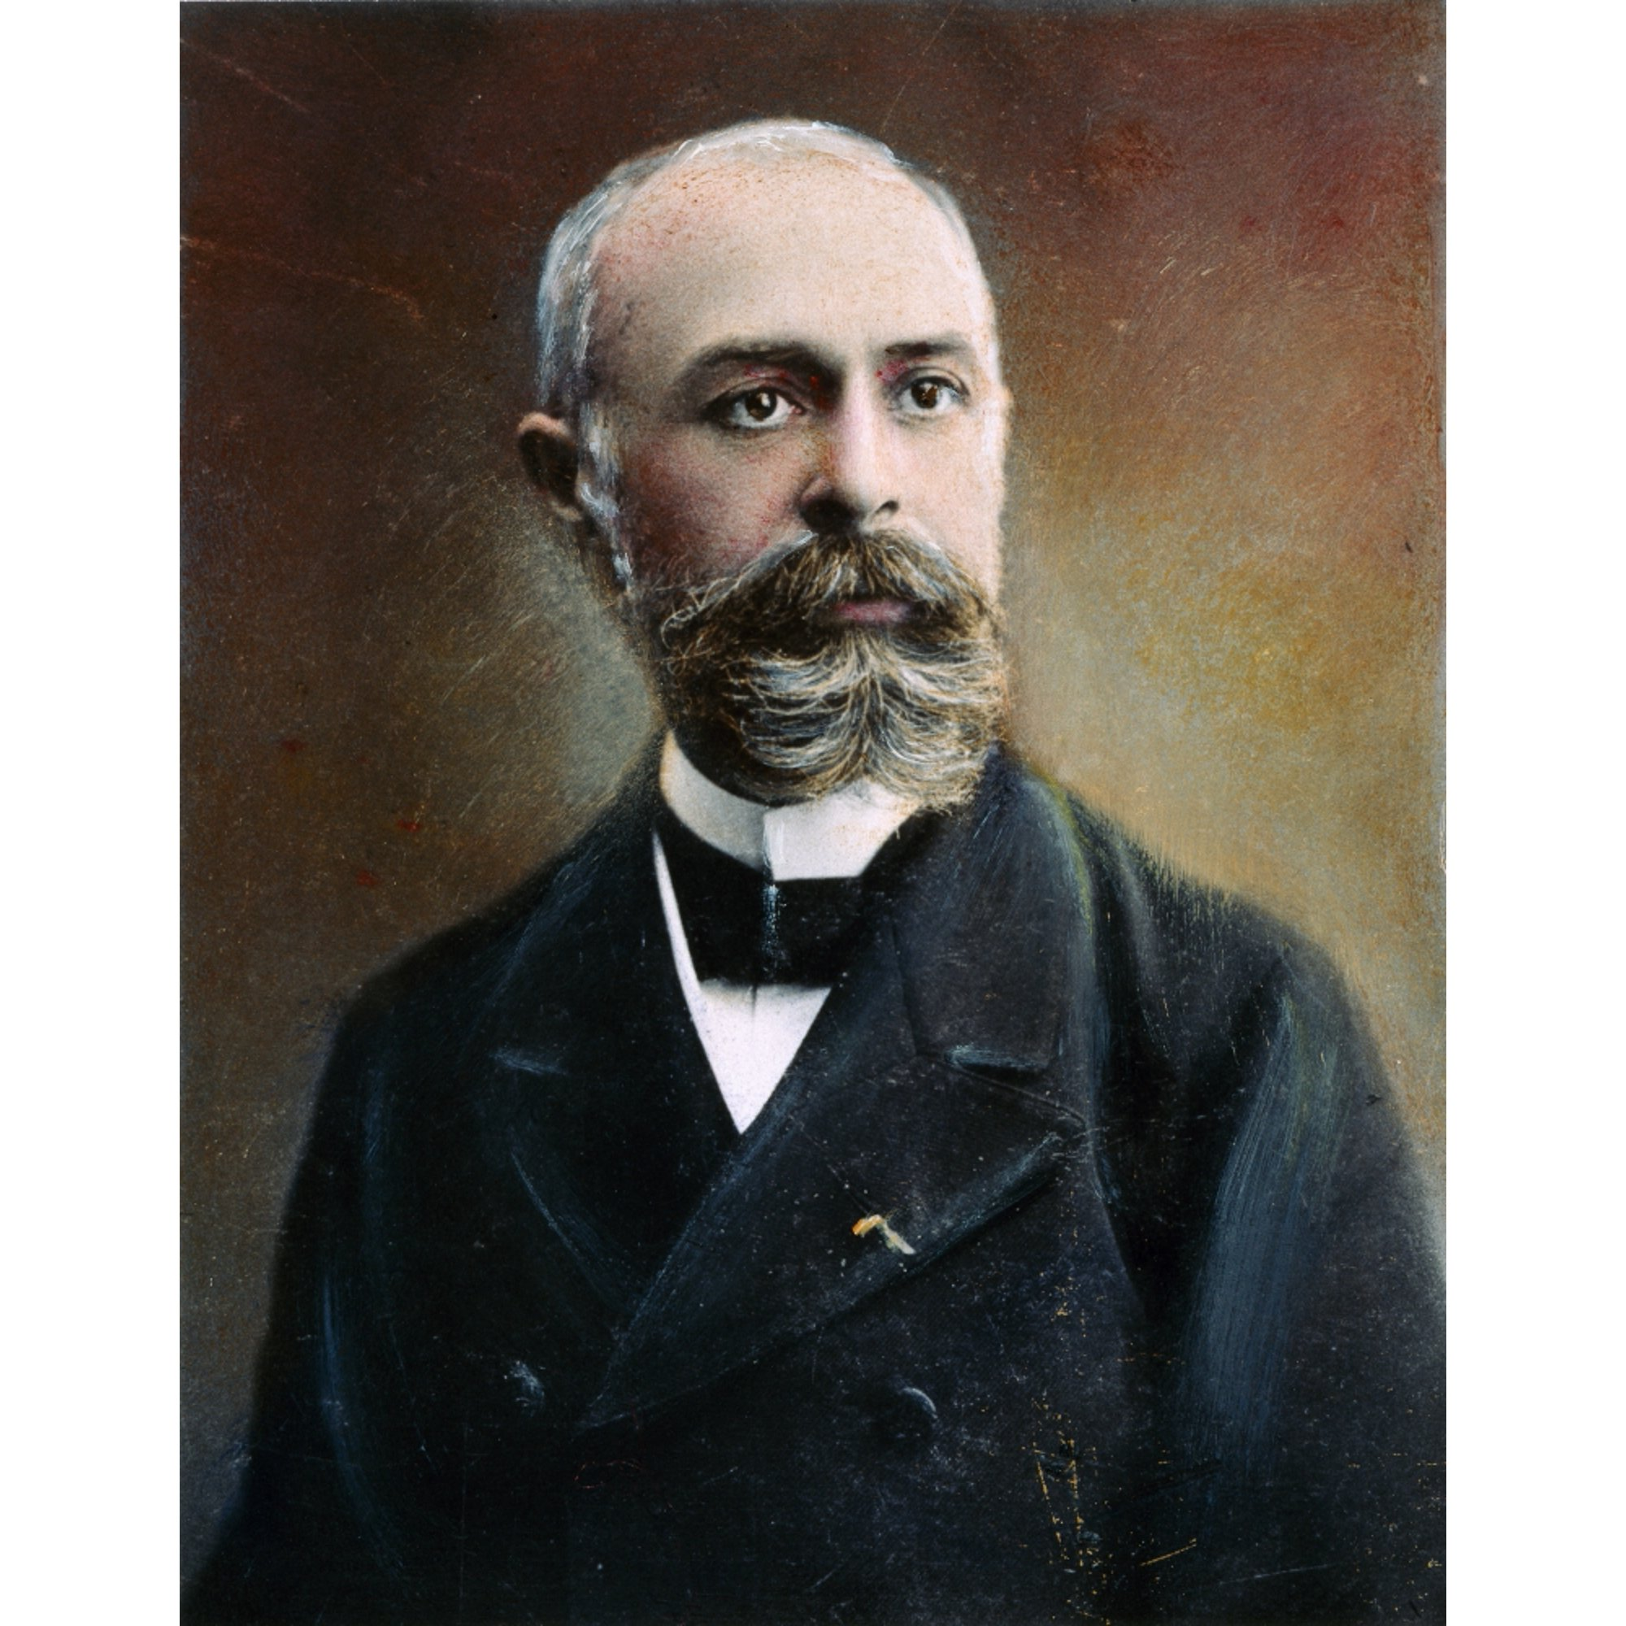
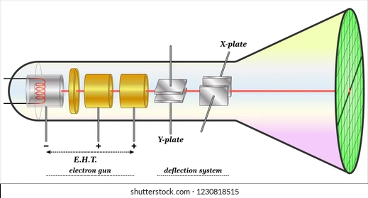
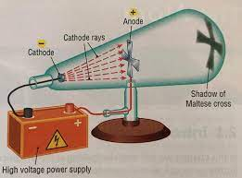
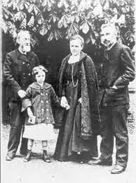
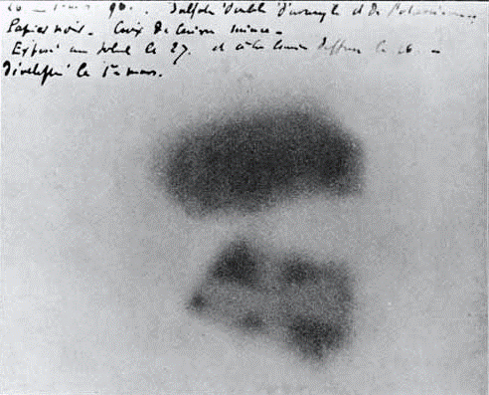
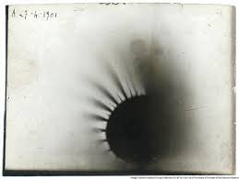
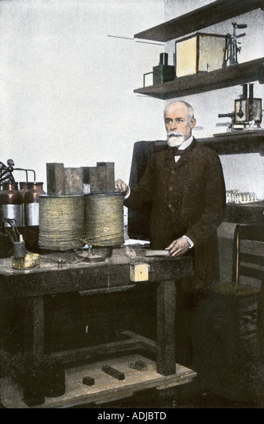
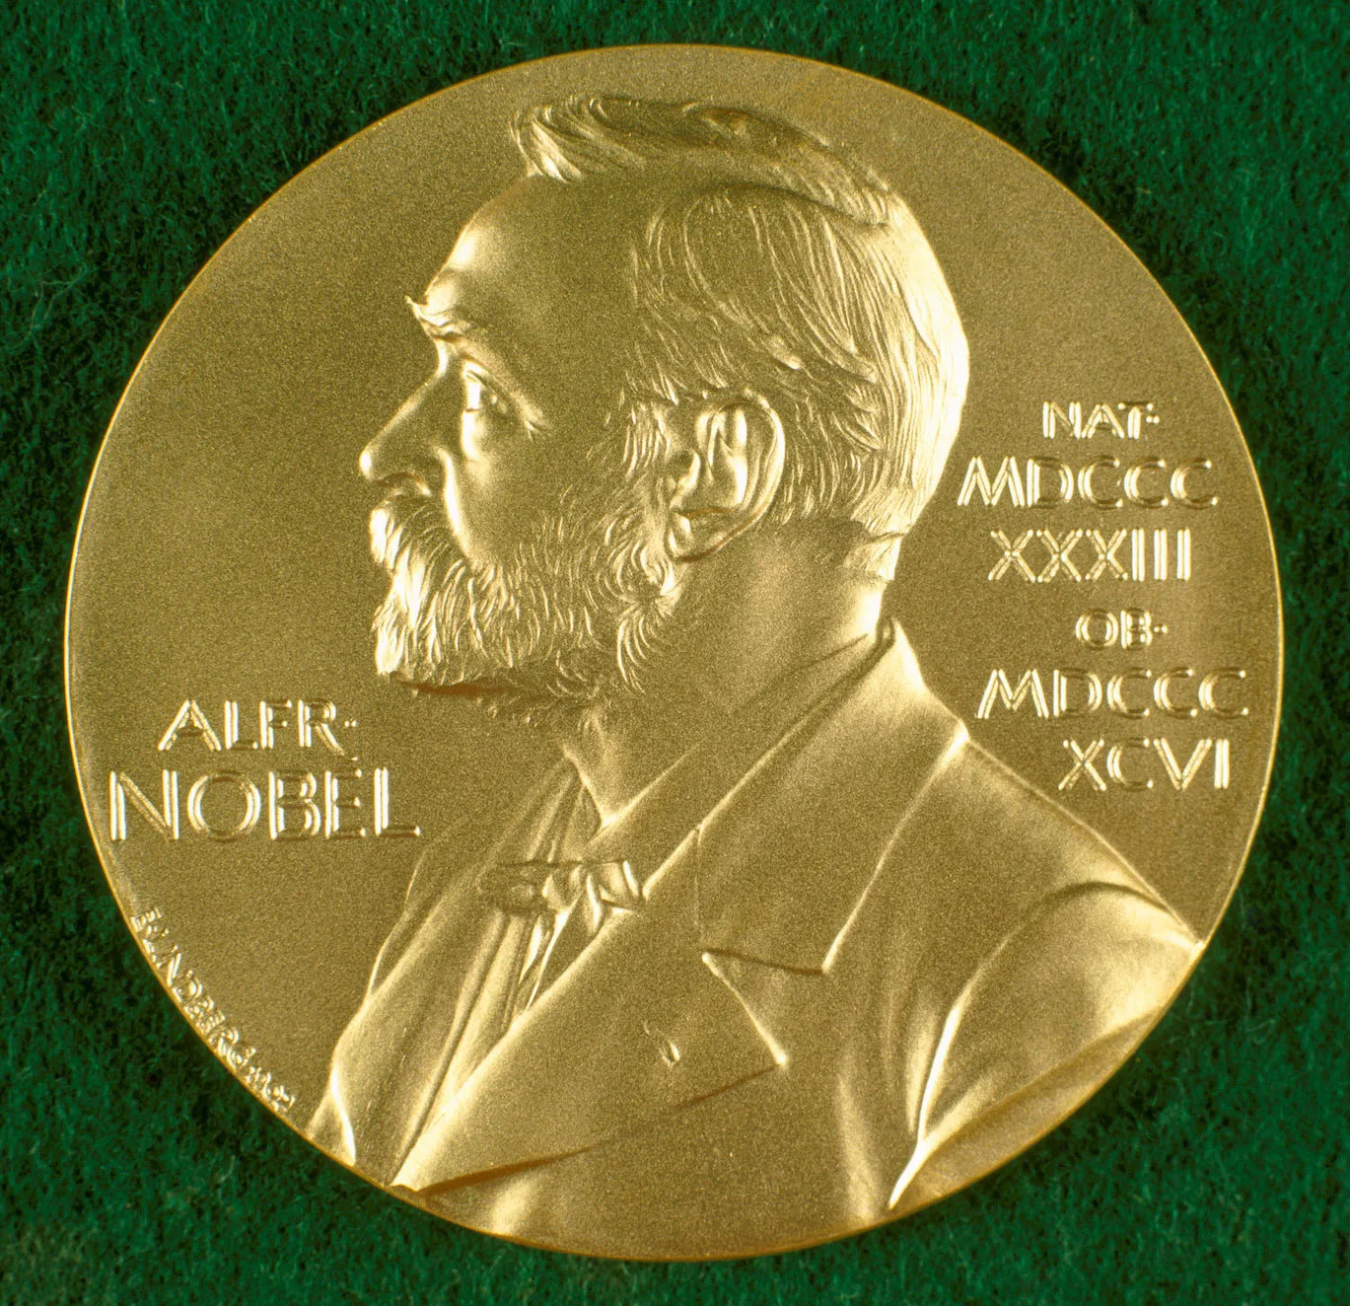
THE EARLY PRECEDENCE OF RADIOACTIVITY : Henri Becquerel And His Pioneering Contributions
Members: SM Walid (23-50005-1), Kawsar Khan(23-50192-1), Abir Tirtha Das(23-50228-1), .Farhan shahriar Joy(23-50306-1), Abu Bakkar Siddik(23-50049-1)
PHYSICS 1 Spring 2022-2023 Section: C1 Group: 04 FACULTY OF SCIENCE & TECHNOLOGY DEPARTMENT OF PHYSICS
AMERICAN INTERNATIONAL UNIVERSITY–BANGLADESH (AIUB)
1. Background:
Medical imaging, cancer treatments, radiometric dating, research into the laws of nature and the origin of matter etc. require the knowledge of Radioactivity, that inspired us to know more about the origin of this discovery in more depth elaboration. Actually, radioactivity was discovered by a French Scientist Henri Becquerel (1852-1908). This poster will explore his pioneering contributions and his significant discoveries.
4. Experiments:
Henri becquerel (1852 - 1908) dedicated most of his effort to luminescent based minerals with great zeal.
Explored the phenomenon of radioactivity and phosphorescence effect by cathode ray examination.
Figure: Henri Becquerel (1852-1908)
2. Biography:
Figure: Cathode ray experiment.
I. Born in 15th December1852, in Paris
5. Contributions:
French academy of Sciences described his findings.
He did his experiment with Lumiere photographic plate with bromide emulsion in two sheets of very thick black paper so that the plate does not become clouded upon being exposed to sun for a day.
A negative image had been noticed on photographic plate.
He described the spontaneous ionization process of uranium salts.
This phenomenon is unlike x-ray mechanism.
Later His discovery used in medicine, MRI, money checker and for other purposes.
II. Physicist, Nobel Laureate
VI. 1890, Married, Louise Désirée Lorieux
III. Discover the evidence of radioactivity
Figure: Henri Becquerel and his family
V. 1874 Married, Lucie Zoé Marie Jamin
IV. Started Education in Lycée Louis-le-Grand school in Paris
Figure: Negative photo effect of Uranium salt.
3. Early life:
I. Entered Polytechnic in 1872
6. Honor and Awards:
Henry Becquerel (1852 - 1908) awarded Nobel prize in Physics with Marie Curie and Pierre Curie in 1903.
In 1900, the Rumford medal had been also awarded to him for the discovery of uranium.
II. Become member of Ponts-et-Chaussées in 1874
VI. Became the professor of polytechnic in 1895
III. Engineering title in 1877, achieved the degree in 1888
V. Promoted to engineer in chief in 1894
Figure: Nobel prize medal.
IV. Appointed as Physicist in Paris museum in the department of Natural history in 1892
7. Death:
Due to having a prolonged concatenation with radioactive, the radiation caused him illness and he left his contributions on his fellows with rest in peace on August 25th ,1908.
Figure: Henri Becquerel (1852 - 1908) in his lab.
References:
[section 2,4,5] Book: Association for Science Education (ASE) (January 1, 1997)Henri Becquerel and Radioactivity: One Hundred Years of Radioactivity at work.
[section 3,5] Book: Marjorie C. Malley [2011]: Radioactivity: A history of a mysterious science, New York IL: Oxford University Press.

